Slide 1
TOURISM
RECOMMENDATION
SYSTEM
PRESENTATION BY : 202IT009 | Kodingari Rajasekhar (M.Tech)
203IT001 | Shankaranarayan N (M.Tech Research IT)
202IT028 | Sibangkar basumatary (M.Tech)
202IT030 | Tushar (M.Tech)
IT700 | Final Project Presentation| 21 Jan 2021

Slide 2
Content
Workflow
Mamdani Fuzzy Model
Methodology
Fuzzification
Route Recomendation
Results
Paper Implementation
Implementation with own dataset and constrains
Implementation with different fuzzy model

Slide 3
Workflow
FINDS
SHORTEST PATH
INPUTS
FUZZY LOGIC
OBJECTS
Fuzzification
Recommendations
OUTPUT
Shortest
Path Algorithm
Distance

Slide 4
Mamdani Fuzzy Model
Crisp
Value
Fuzzy i/p
Value
Fuzzy i/p
Value
Crisp o/p
Value
Fuzzifier
Inference
Defuzzifier
Fuzzy
Knowledge
Base

Slide 5
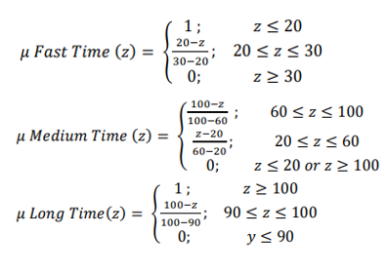
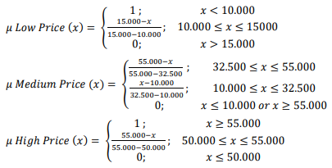
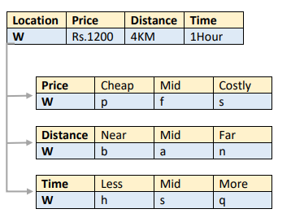
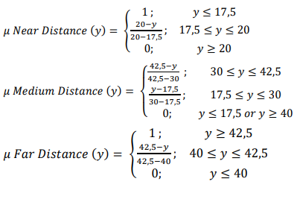
So, what is happening ?

Slide 6
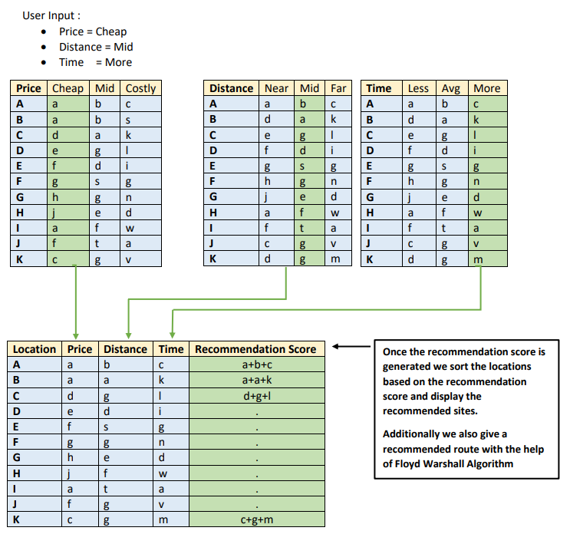
So, what is happening ?
A TYPICAL RECOMMENDATION SCORE GENERATION PROCESS

Slide 7
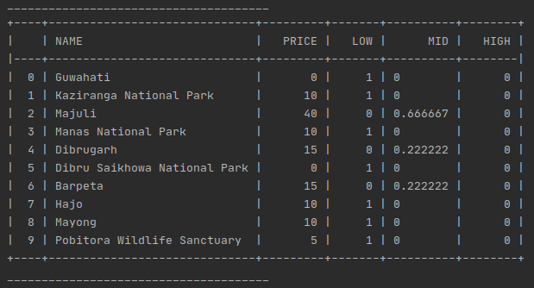
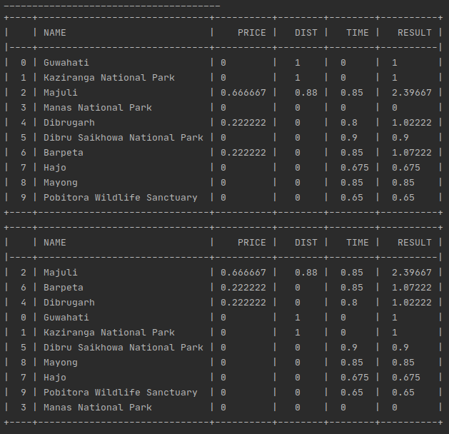
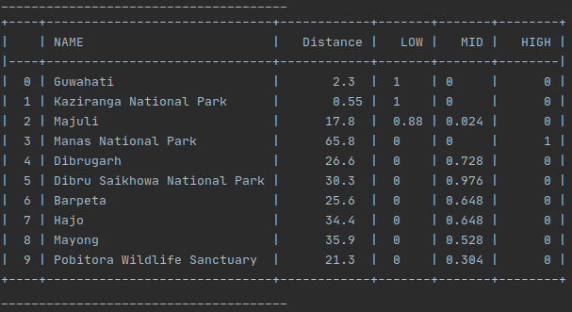
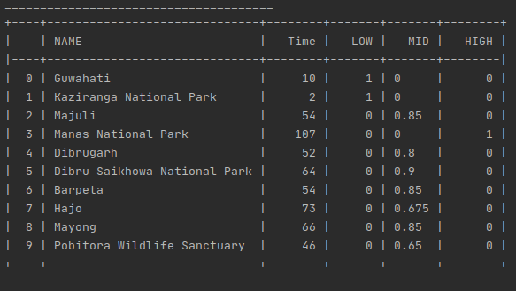
Results
This is the result/recommendations obtained
with the help of Mamdani Fuzzy logic

Slide 8
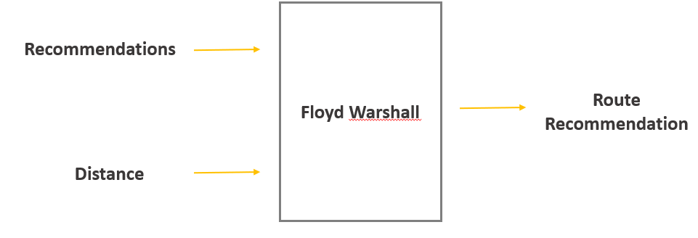
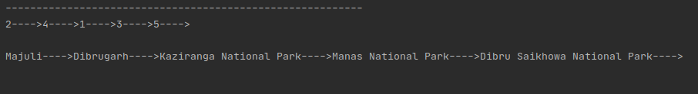
Route Recommendation
ROUTE RECOMMENDATION RESULT

Slide 9
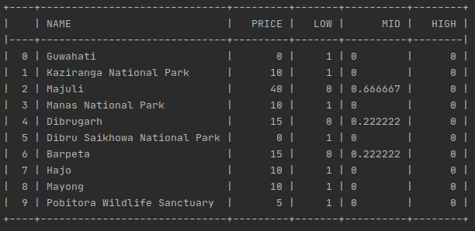
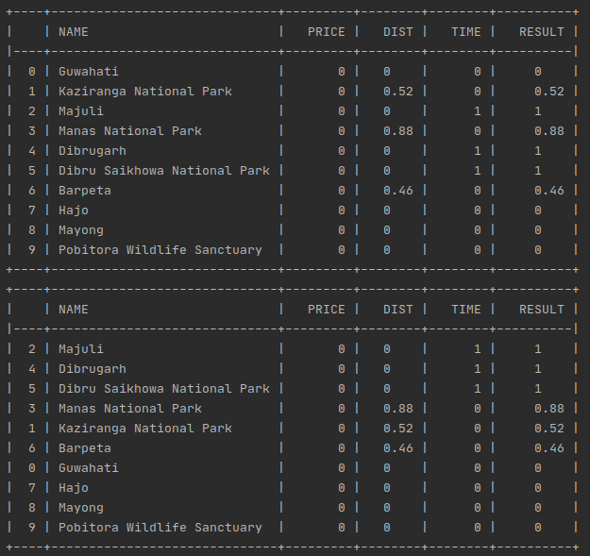
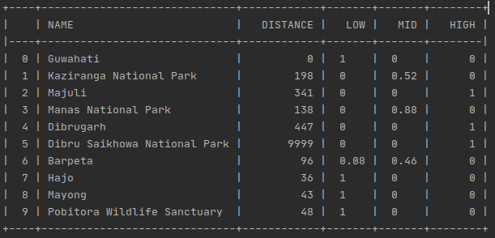
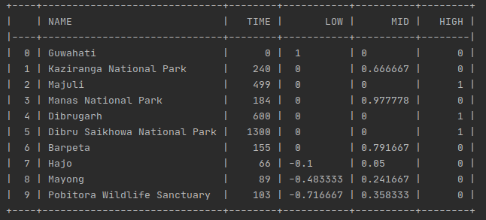
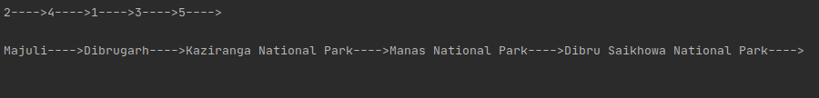
Results [Mamdani - Custom Data]
This is the result/recommendations obtained with the help of customized Mamdani

Slide 10
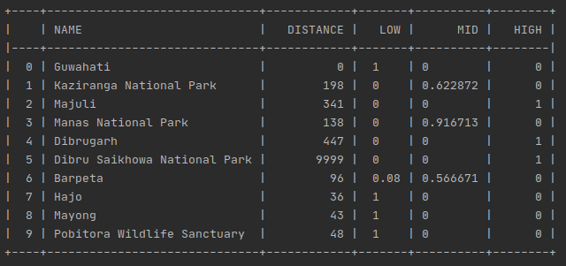
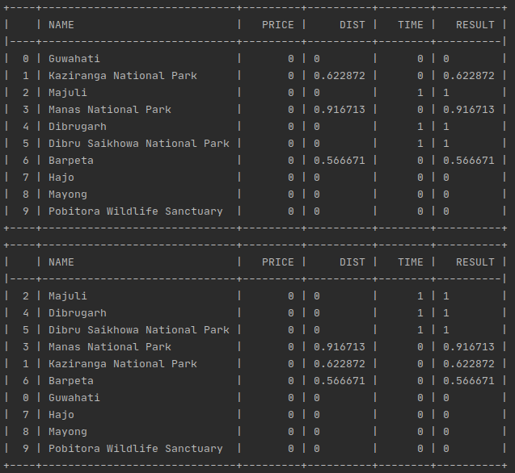
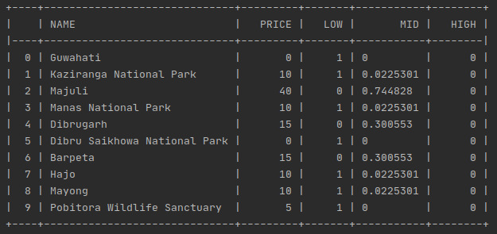
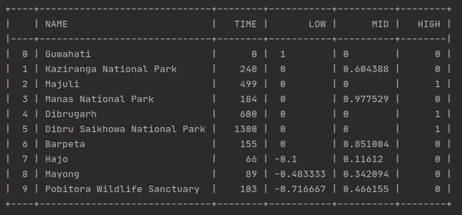
Results [Gaussian – Custom Data]
This is the result/recommendations obtained with the help of Gaussian Fuzzy logic

Slide 11
THANK YOU
203IT001 | Shankaranarayan N [Paper Implementation-Mamdani Logic, Presentation and Report Writing]
202IT009 | Kodingari Rajasekhar [Mamdani Logic customization, Route Recommendation]
202IT030 | Tushar [Gaussian Logic]
202IT028 | Sibangkar basumatary [Tsukamoto Fuzzy Logic - Incomplete]

